Slide 1

Bank Loan Report Analysis
Comprehensive Portfolio Performance, Risk Metrics & Key Financial Insights
SQL & Power BI Portfolio Risk Analytics Financial Services

Slide 2

Executive Summary
Project Objective
To evaluate the bank's lending activities, monitor overall portfolio health, and uncover actionable insights regarding repayment behaviors, risk exposure, and loan profitability.
Analytical Approach
Leveraged advanced SQL queries to process structured loan datasets and built interactive Power BI dashboards to perform Month-to-Date (MTD) and Month-over-Month (MoM) trend analysis.

Slide 3




Primary Portfolio KPIs
TOTAL APPLICATIONS
TOTAL FUNDED AMOUNT
TOTAL AMOUNT RECEIVED
AVG INTEREST RATE
38.6K
$435.8M
$473.1M
12.0%
+6.9% MoM
+13.0% MoM
+15.8% MoM
Stable
Key Takeaway: Capital recovery remains strong with $473.1M received against $435.8M funded, indicating positive net cash inflows across active loan accounts.

Slide 4


Good Loan vs. Bad Loan Analysis
Good Loans (Fully Paid / Current)
33.2K Applications | $370.2M Funded
Bad Loans (Charged Off / Defaulted)
5.3K Applications | $65.5M Funded (13.8%)

Slide 5
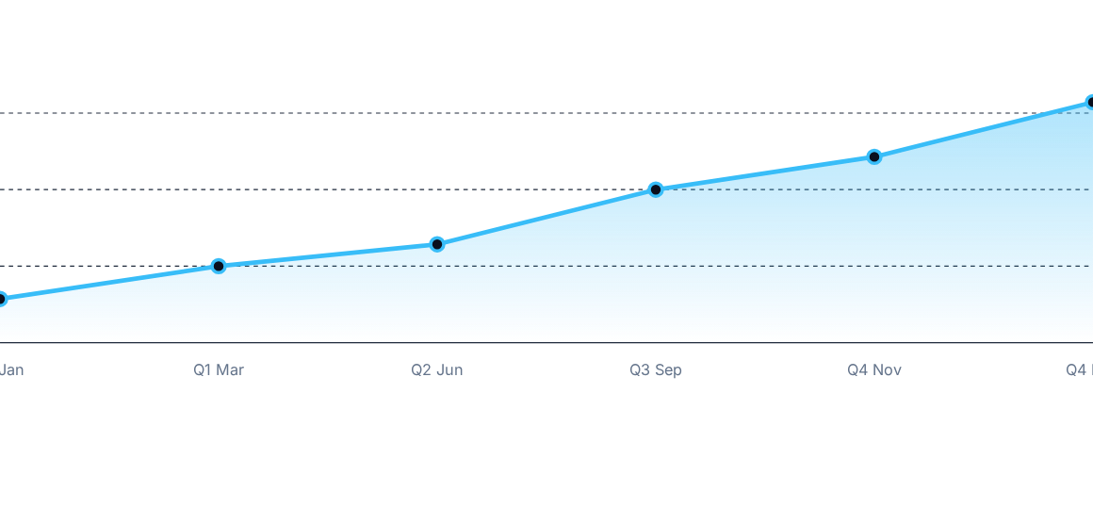
Monthly Issue Volume Trend (2025)
Consistent growth observed throughout the year, peaking in Q4 due to high seasonal credit demand.

Slide 6
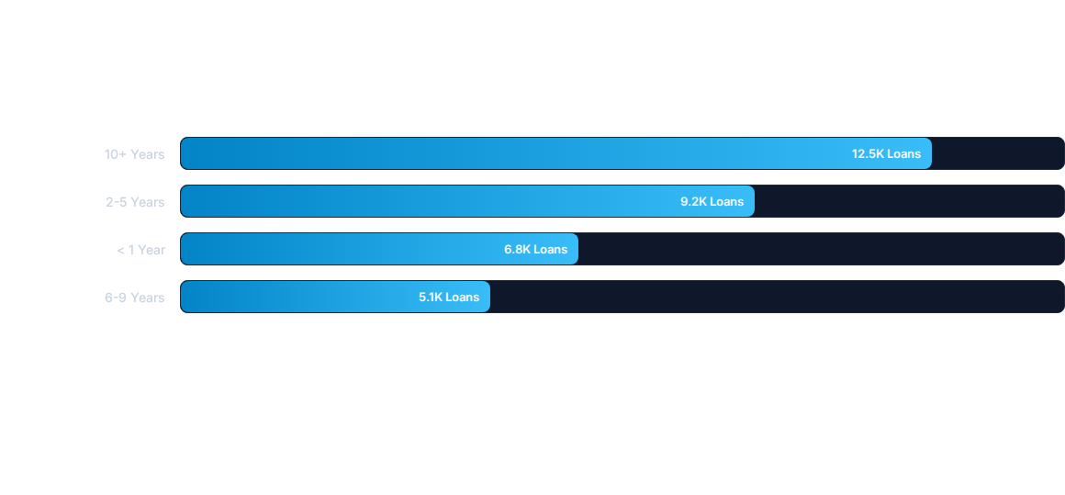
Loan Distribution by Employment Length
Borrowers with 10+ years of employment account for the largest proportion of total applications and exhibit lower default rates.

Slide 7






Loan Applications by Purpose
Debt Consolidation
Credit Card Payoff
Home / Business
Represents 52% of total volume ($226M funded). Main driver for borrower refinancing.
Accounts for 21% of total loans. Exhibits strong repayment consistency.
Comprises 15% of loans. Requires closer monitoring due to variable DTI ratios.

Slide 8

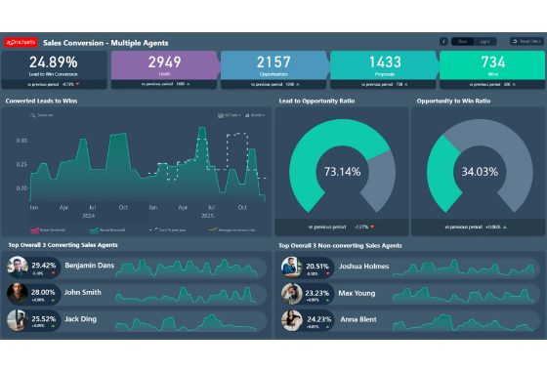
Regional Lending Disparities
Top High-Volume States: California, Texas, and New York represent over 38% of total funded volume.
Risk Variance: Southern regions show higher average Debt-to-Income (DTI) ratios (14.2% vs 12.8% national average).
Strategic Action: Adjust regional underwriting thresholds to mitigate localized credit default risk.

Slide 9
Loan Term & Homeownership Breakdown
Homeownership | 36-Month Term | 60-Month Term | Avg Interest Rate | Default Rate
RENT | 14,200 | 4,200 | 11.8% | 14.5%
MORTGAGE | 12,800 | 5,400 | 12.2% | 12.1%
OWN | 2,100 | 700 | 11.5% | 11.8%

Slide 10
Key Credit Risk Drivers
High DTI Sensitivity: Borrowers with Debt-to-Income ratios above 18% show a 2.4x higher likelihood of defaulting.
Interest Rate Impact: Interest rates exceeding 15% directly correlate with elevated charge-off percentages in 60-month loan terms.
Mitigation Strategy: Implement stricter capping on maximum high-risk DTI applicants during initial credit screening.

Slide 11




Portfolio Optimization Roadmap
Policy Refinement
Product Pricing
Regional Capping
Automated Tracking
Tighten underwriting caps on borrowers with >18% DTI ratios.
Re-evaluate interest rate pricing models for 60-month terms.
Adjust regional exposure ceilings based on local default trends.
Deploy real-time SQL & Power BI early warning dashboards.

